Slide 1
PowerApps and Power Automate Training
By Visual Path
Trainer : Hemendra

Slide 2

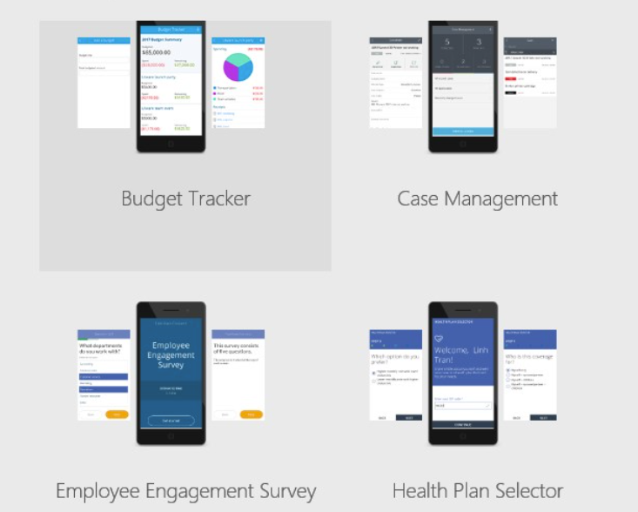
What is Power Apps?
Microsoft designed the Power Platform and Power Apps to let you build any business application based on your data.
Power Apps helps create custom applications that allow your team to efficiently communicate and share information.
Its highly intuitive interface was designed to allow as many people as possible to create unlimited apps.
Save time and resources on training and coding, while meeting your business needs with the most personalized solution.
Specifically, it allows you to create the app that best suits your needs with your own data source, with basic programming or app development skills.
Your custom applications can be fully linked to your Microsoft solutions or other IT tools already used in your business.

Slide 3
Types of Power Apps
Canvas PowerApps
Model-Driven PowerApps
Power Pages

Slide 4
Module – 1

Slide 5
Introduction to Microsoft Power Apps
Microsoft 365 E3 | Microsoft 365 Enterprise
Power Apps Studio

Slide 6
Learning resources
Microsoft Power Platform: Learning Resources | Microsoft Power Apps

